Slide 1
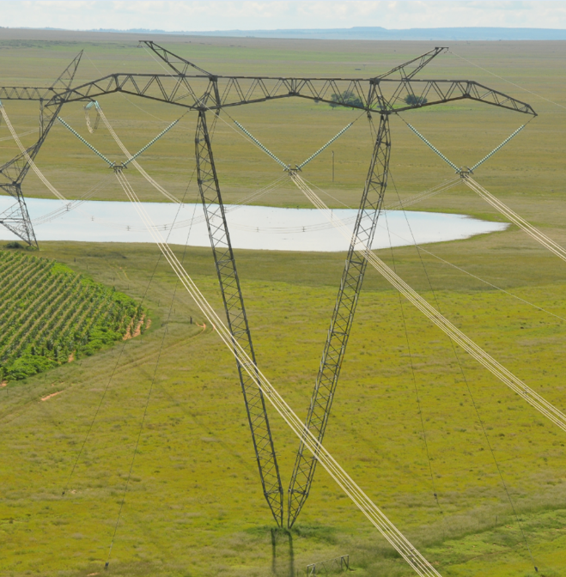
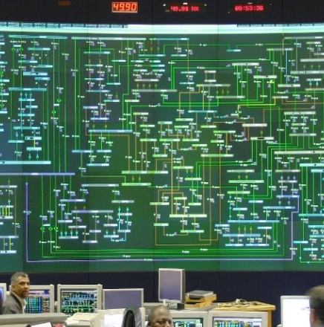
Weekly System Status
Compiled by: System Operator
2025 Week 43 (20/10/2025 – 26/10/2025)

Slide 2
Introduction and Disclaimer
Introduction
This document is intended to provide a general picture of the Adequacy of the National Electricity Supply System in the medium term. The Report will be updated weekly, on Tuesdays and circulated Wednesdays, thereafter, published on the Eskom website, updated on Wednesdays. The values contained in this report are unverified and not official yet and can change at any time.
Disclaimer
The Data published here is for information purposes only. The content is subject to verification and validation. Eskom shall not be held responsible for any errors or it being misleading or incomplete and accepts no liability whatsoever for any loss, damages or expenses, howsoever, incurred or suffered, resulting or arising, from the use of this Data or any reliance placed on it.

Slide 3
Historic Daily Peak System Capacity/Demand
Available Dispatchable Generation means all generation resources that can be dispatched by Eskom and includes capacity available from all emergency generation resources.
RSA Contracted Load Forecast is the total official day-ahead hourly forecast. Residual Load Forecast excludes the expected generation from renewables.
Actual Residual Demand is the aggregated metered hourly sent-out generation and imports from dispatchable resources and includes demand reductions. The Actual RSA Contracted Demand includes renewable generation.
Net Maximum Dispatchable Capacity (including imports and emergency generation resources) = 51 385 MW. (Kusile Unit 6 Commercial 30 September 2025)
These figures do not include any demand side products.
The peak hours for the residual demand can differ from that of the RSA contracted demand, depending on renewable generation.

Slide 4
Week-on-Week Dispatchable Generation Energy Sent Out

Slide 5
Week-on-Week Residual Energy Demand

Slide 6
Week-on-Week RSA Contracted Energy Demand

Slide 7
Week-on-Week Dispatchable Generation Peak Demand

Slide 8
Week-on-Week Residual Peak Demand

Slide 9
Week-on-Week RSA Contracted Peak Demand

Slide 10
Weekly Generation Availability
EAF: Ratio of the available energy generation over a given time period to the maximum amount of energy which could be produced over the same time period.
Outage Factors: Ratio of the energy losses over a given time period to the maximum amount of energy which could be produced over the same time period.
YTD: Year-to-Date (01 January of current year to current week)

Slide 11
52 Week Outlook
The maintenance plan included in these assumptions includes a base scenario of outages (planned risk level). As there is opportunity for further outages, these will be included. This “likely risk scenario” includes an additional 1500 MW of outages on the base plan.
The expected import at Apollo is included. Avon and Dedisa is also included.
The forecast used is the latest operational weekly residual peak forecast, which excludes the expected renewable generation.
Operating Reserve (OR) from Generation: 2 200 MW
Unplanned Outage Assumption (UA):
13 000 MW
Reserves: OR + UA = 15 200 MW
Eskom Installed Capacity: 50 230 MW (Kusile Unit 6 Commercial 30 September 2025)
Installed Dispatchable Capacity: 51 385 MW (Incl. Avon and Dedisa)

Slide 12
Renewable Energy Statistics
Note: Times are expressed as hour beginning

Slide 13
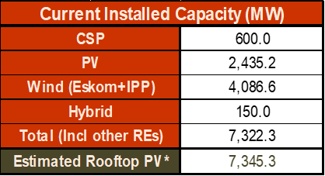
Estimated Rooftop PV
If there is a big jump from month to month it is mainly due to the high number of cloudy days during the latter month, not necessarily due to the number of installations in that month. It would very likely have been distributed in the preceding few months.
*Rooftop PV includes ground-mounted as well as all other PV installations that do not have contracts with NTCSA.

Slide 14
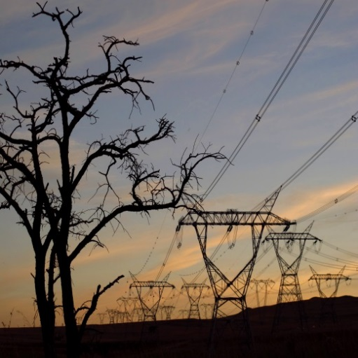
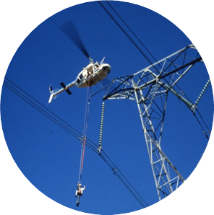
Thank You

